Slide 2
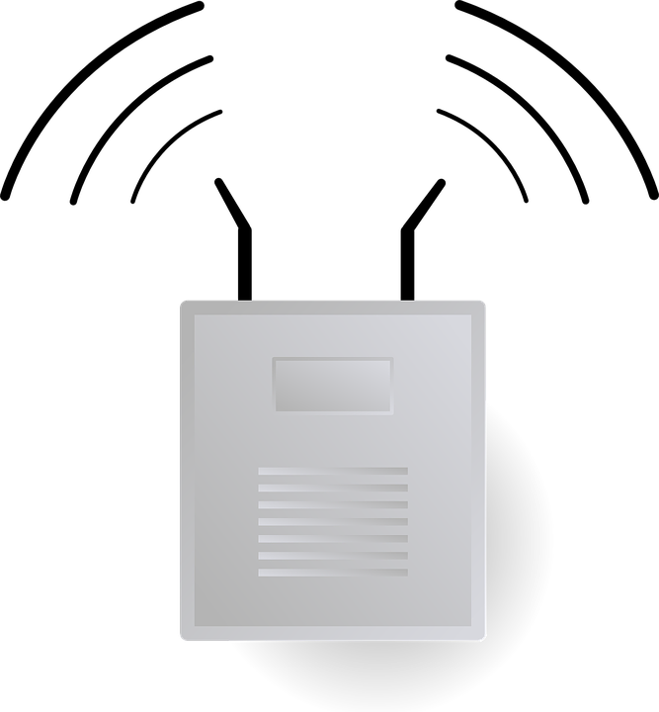


Network Attacks - Wireless
SSID - ITProTV
Rogue AP
Authorized AP
Notes:
Various attack happening around the globe

Slide 3

Network Attacks - Wireless
SSID - ITProTV
SSID - ITProTV
Evil Twin
Authorized AP
Notes:
Various attack happening around the globe

Slide 4
Network Attacks - Wireless
forged frame
SSID - ITProTV
Evil Twin
SSID - ITProTV
Notes:
Various attack happening around the globe

Slide 5


Network Attacks - Wireless
Initialization Vector
random number 1
random number 2
+
+
secret key
secret key
secret key
secret key
Data 1
Data 1
Data 1
same data
Data 1
1df2435g
1df2435g
1df2435g
7lk5njlj14
unique output
Notes:
Various attack happening around the globe

Slide 6
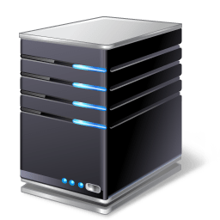
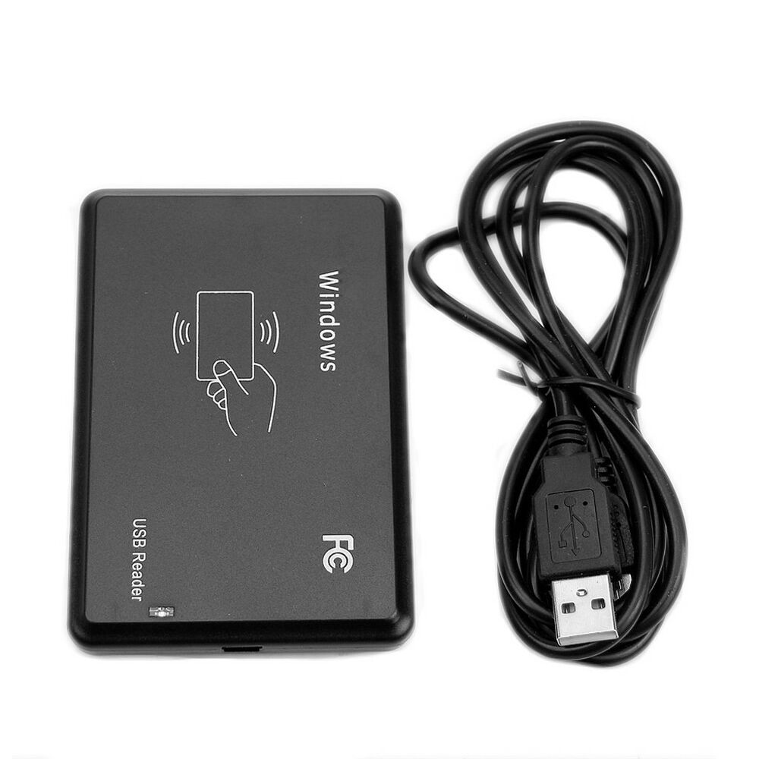
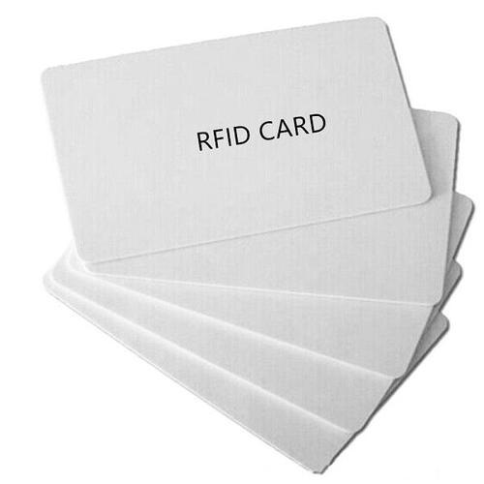
Network Attacks - Wireless
Radio frequency identifier (RFID)
Reverse engineering
Power analysis
Eavesdropping
Cloning/Spoofing
Middleware
Notes:
Wireless information transfer between transponder(chip, tag, label) and reader Various attack happening around the globe
Short Range – 15 centimeters
Mid Range – 5 meters
Long Range – 500 meters

Slide 7

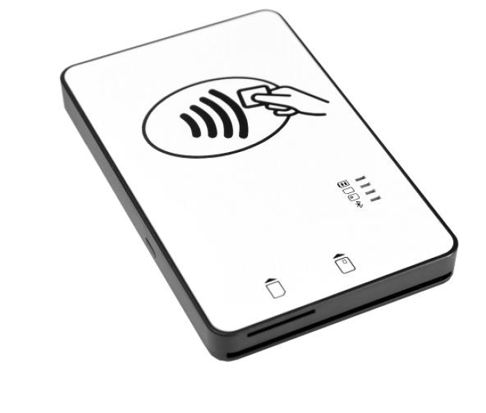
Network Attacks - Wireless
Near-field communication (NFC)
Eavesdropping
Data modifications/theft
Relay Attack (not replay*)
Victim
Card emulation
Reader
Malicious reader
Notes:
mobile devices Payments
Electronic ID
Electronic ticketing in transportation
P2P Data Transfers
Device Pairing
Customer Loyalty programs

Slide 8
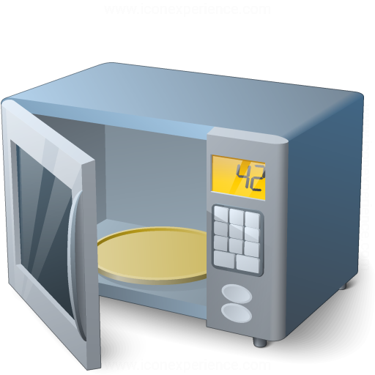
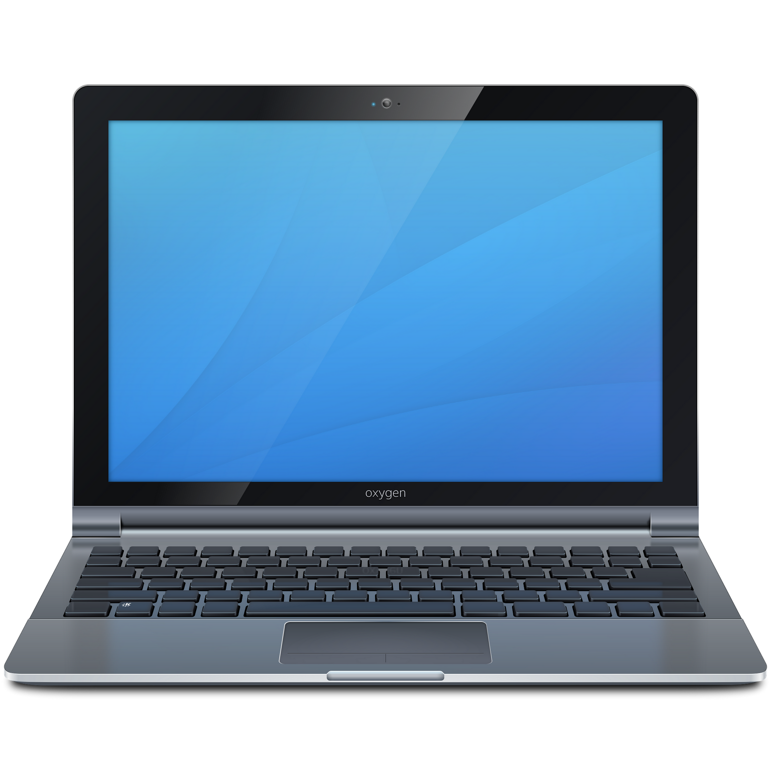
Network Attacks - Wireless
Notes:
Various attack happening around the globe

Slide 9

Network Attacks - Wireless
Bluejacking
Bluesnarfing
Data
Data
Notes:
Various attack happening around the globe

Slide 10
Network Attacks - Wireless
Bluejacking
Notes:
Various attack happening around the globe

